Slide 1
House Bestiary
By David Ramírez

Slide 2
What is this?
A bestiary serves as a recompilation of various animals or living species and their role in their respective habitat.
The focus of this bestiary is to observe and build a better understanding of wild animals making their living in our shared habitat.
There will often be two pictures, one taken by me and another that serves as an auxiliary reference.
In some cases, photos and videos will be included.

Slide 3
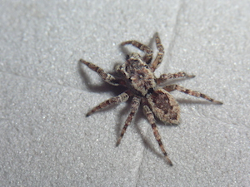
Jumping Spiders
This is the typical spider one finds inside home.
Very small is size but may grow larger in other habitats.
Feeds on a variety of things, mostly on other insects, but is also known to take flower nectar as a supplement.
If not found inside home, you can probably find them in the closest garden.
Actually a good hunting species to have around, considering all the other insects that I have found relatively close by.
(In reality I know there are way more species living in my garden, but when I went outside to take pictures NONE decided to show up).

Slide 4
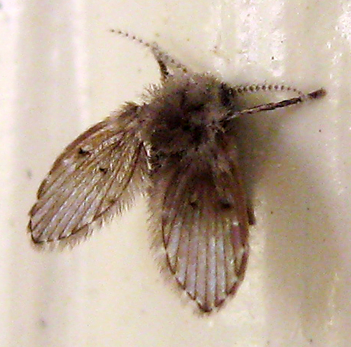
Moth Fly
This is actually a species that I have seen in various occasions, but never figured out what made it different of other types of flies.
Now I know.
Mostly accustomed to tropical environments.
Tends to live in bathrooms.
Mostly not dangerous, though may become problematic if left alone.

Slide 5
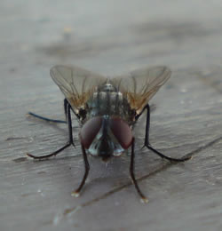
Flies
The typical bothersome type of insect found everywhere.
Useful for breaking down organic matter.
Not specifically dangerous to humans, but it may transport disease.
Good food source for my jumping spiders (yay).

Slide 6
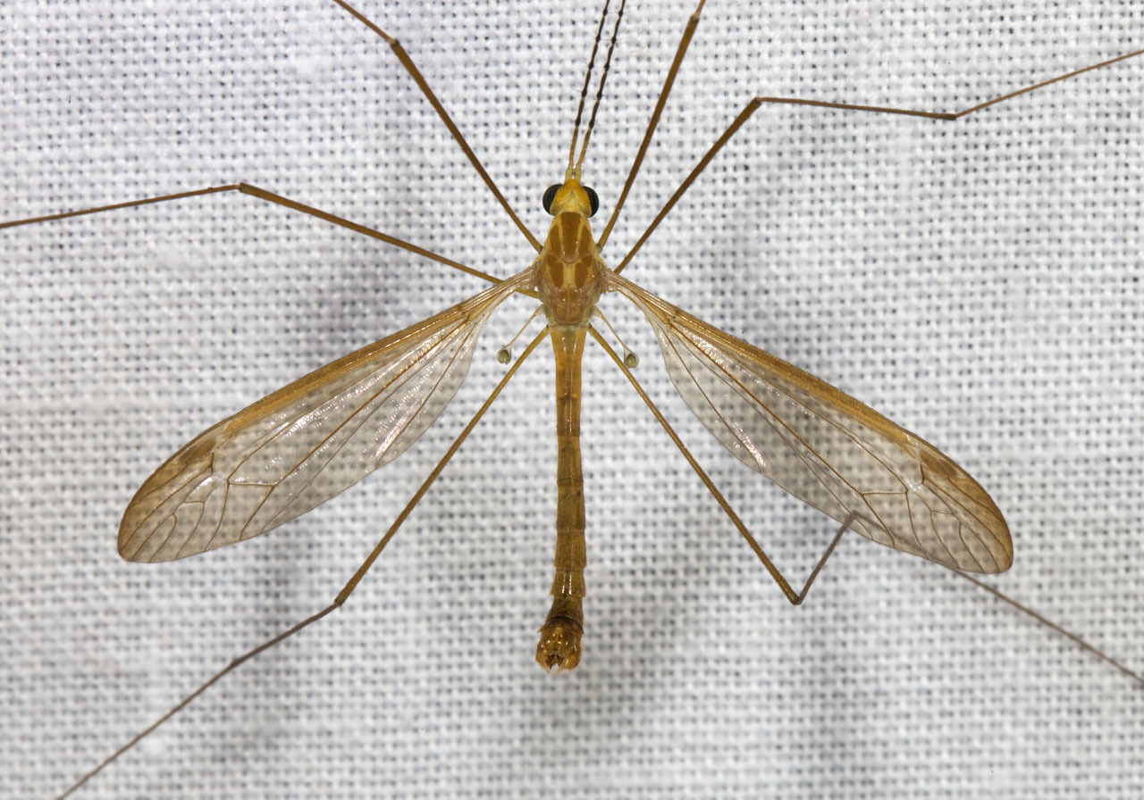
Crane Flies
Subfamily of the regular flies.
Feeds on decaying plants.
Receives its name because of its elongated legs.
Found worldwide but in different sizes.
Not the same as a mosquito, that one may bite people.
Again, good pray for the spiders.

Slide 7
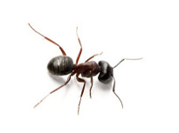
Ants
Regular run-of-the-mill insect found pretty much everywhere on the planet.
They play a role in biological control.
Very, very small in size.
They eat pretty much anything, but I found that in a city space they tend to be more herbivores than carnivores.

Slide 8
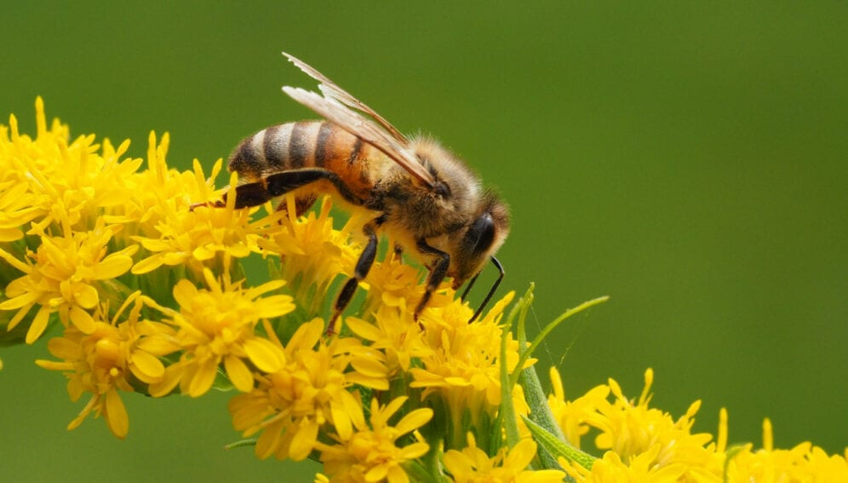
Bees
One of the friendliest species towards plants.
Play a great role in pollination.
Pretty much found anywhere where there are flowers.
Normally not aggressive towards humans.
They are crucial for keeping a healthy environment. If they disappear pretty much all plants, go with them as well. By the same reason, its important to not disturb them.

Slide 9
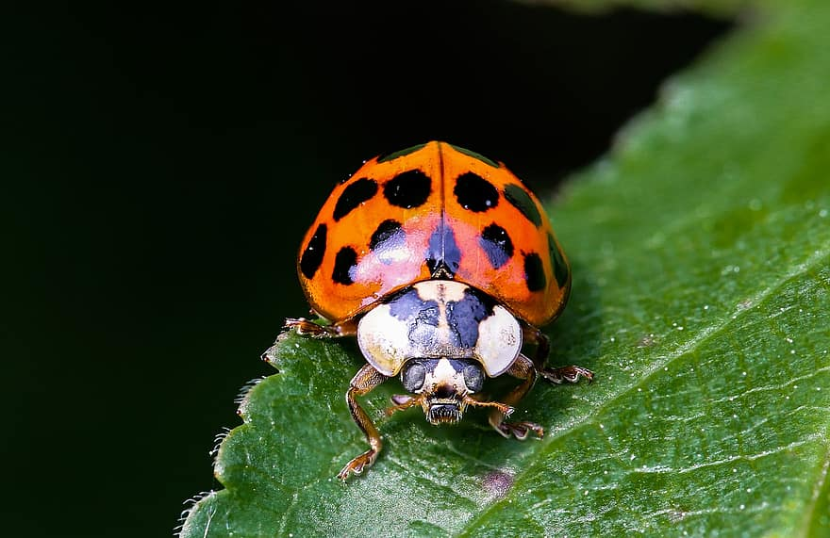
Ladybug
Another of the friendliest species towards plants.
Because of their color pattern, most predators tend to avoid them.
Great for keeping pests at bay.
Inoffensive towards humans.
This might be outside of subject, but the round shape may give the idea of a friendly, adorable insect. Many insects have distinctive shapes, and they might give you a good idea before approaching them.

Slide 10
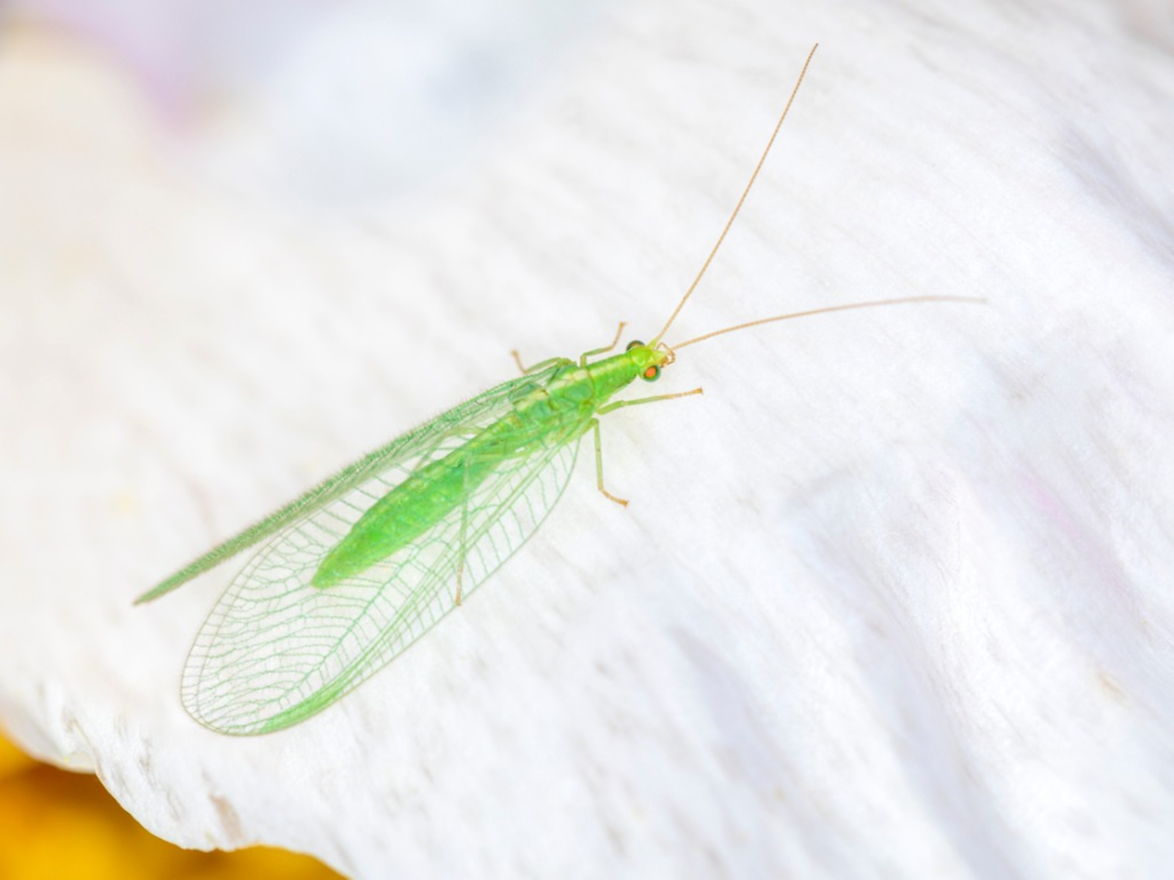
Lacewing
I did not know what this where before taking the picture.
I have seen them but never cared to research about them.
Similar as ladybugs, they work as pest controllers, but mostly exclusively for plants.
I find them really interesting overall.

Slide 11
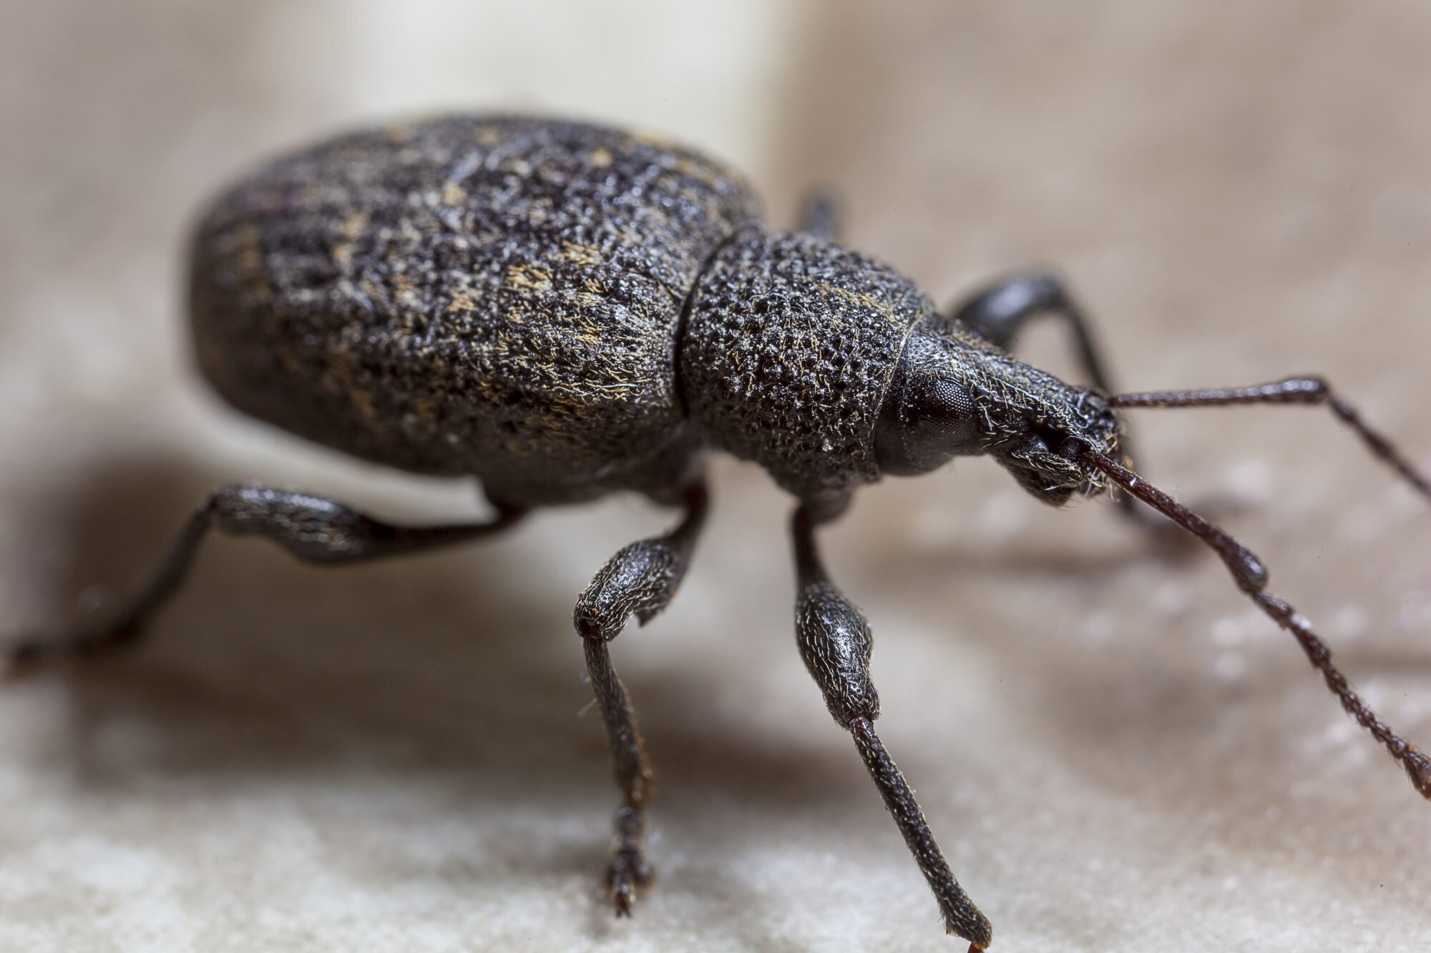
Weevil
These are not good, in big numbers at least.
Even in small numbers they can be threatening.
Although not dangerous to humans, they are dangerous to crops.
It is a herbivore species, and could be used to treat invasive species, but getting rid of them afterwards is tough.
I know this because I already had to deal with them. They are very tough overall.

Slide 12
Hummingbird
Now for a change of scenery.
No more insects from this point onward.
This is one of my favorite birds and I’m glad I got to see one the day I went out for pictures.
Not only that but I got to also record it (the record button should be on the right-down side).
Feeds on nectar mostly.
Not a danger for humans.

Slide 13
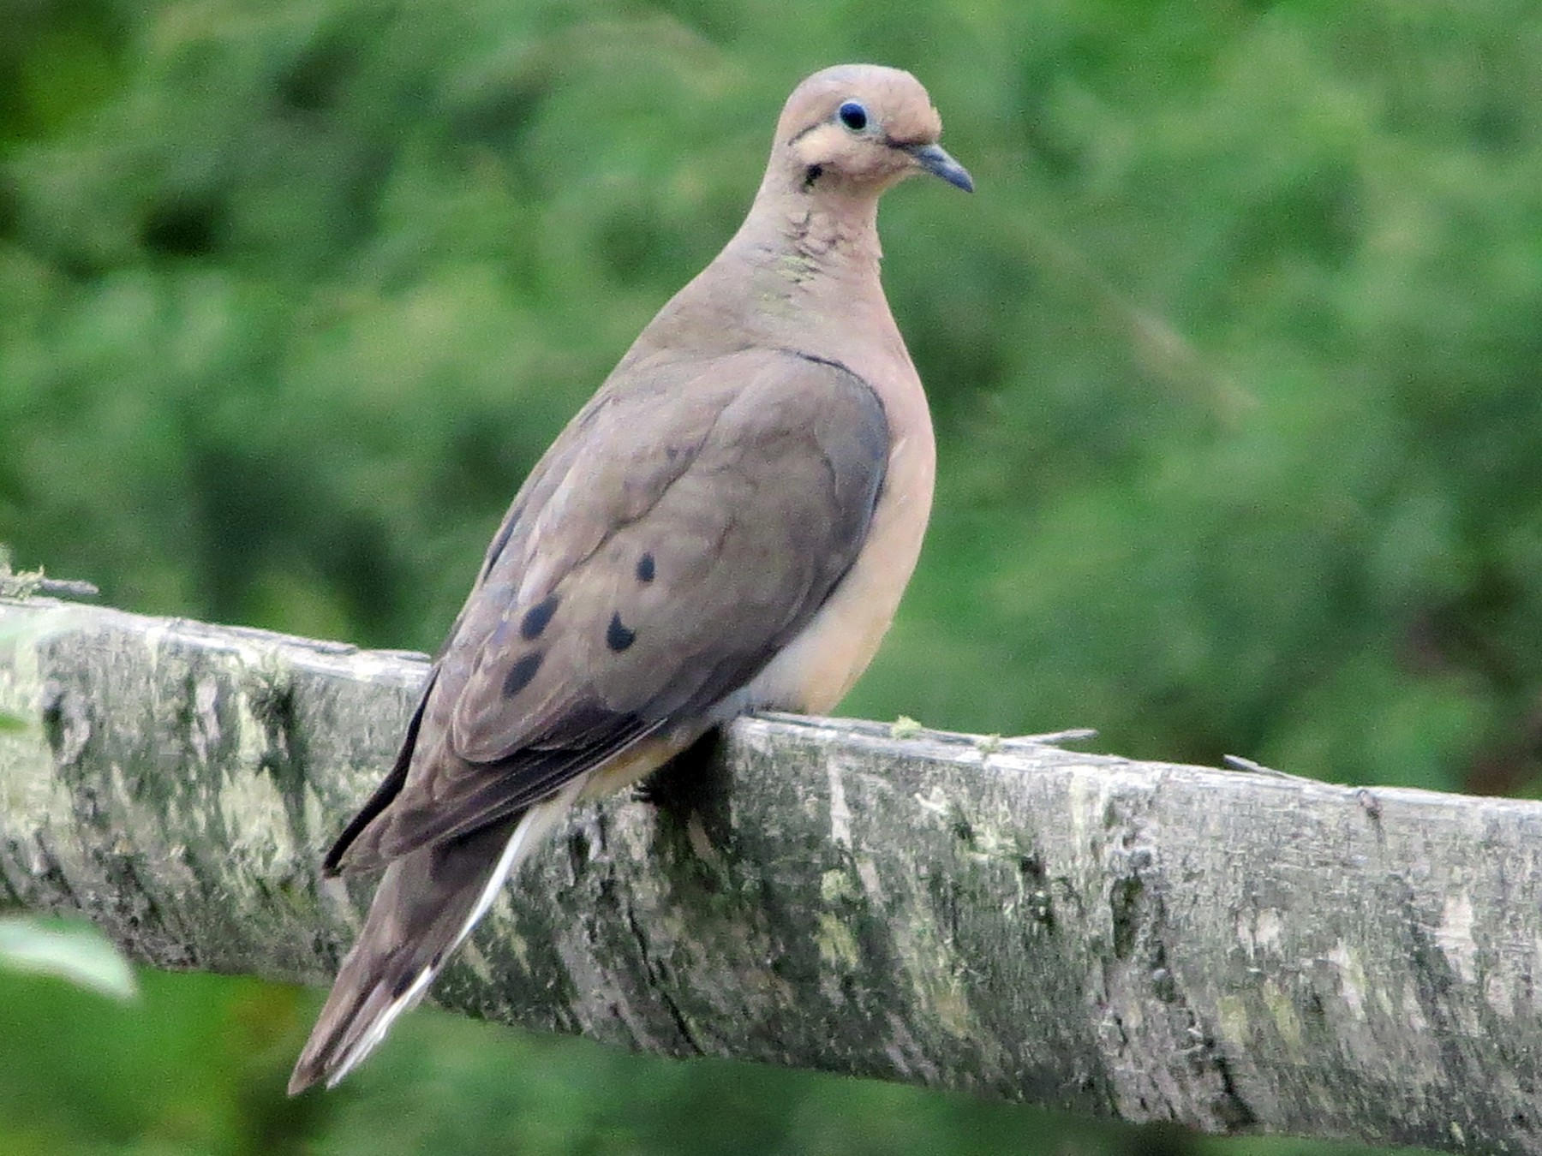
Doves
This one I tend to not like, because there are so many of them.
Also, one of the most common on the city.
Unfortunately for me, there were almost none the day I went to take pictures of them.
These are weird for me because I never feed them, but are(almost) always on my backyard. I guess they eat seeds or something of the sort.

Slide 14
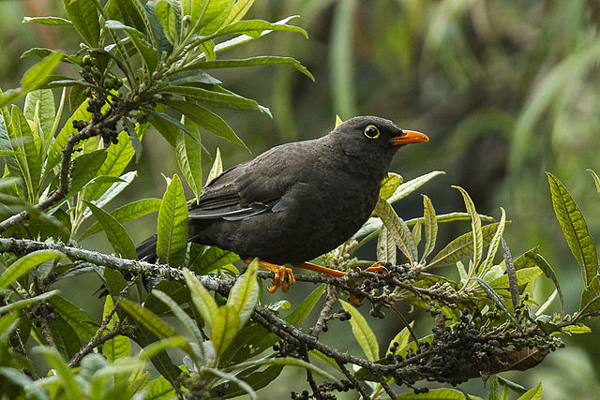
Great Thrush
I didn’t know the name of this species.
I often confused them with crows.
Turns out they are a local species of bird.
Likes eating fruits.
Very territorial.

Slide 15
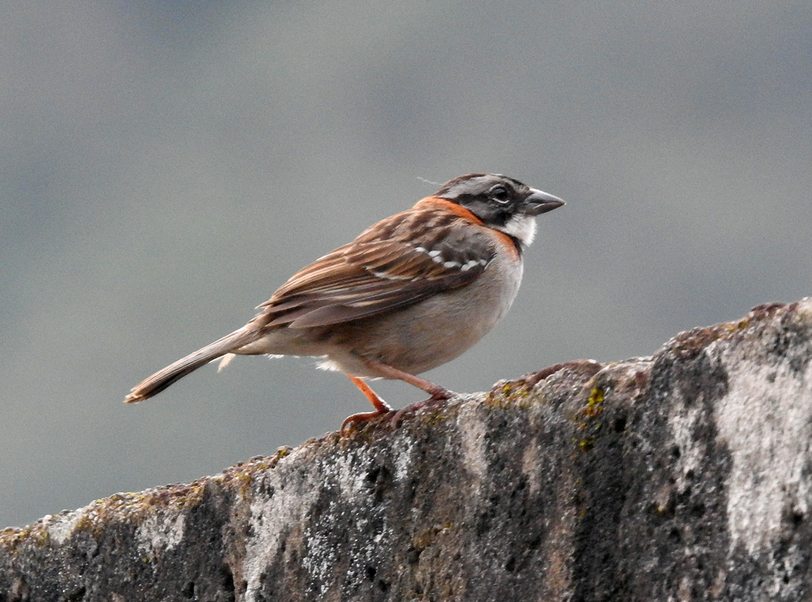
Rufous-collered Sparrow
Again, I didn’t know the name of this species.
Also a local species of bird.
From al the birds in the pictures this one is the most commonly found here in Quito (not counting doves for that matter).
Feeds on grains and insects.
Very hrad to take a photo (they often run away).

Slide 16
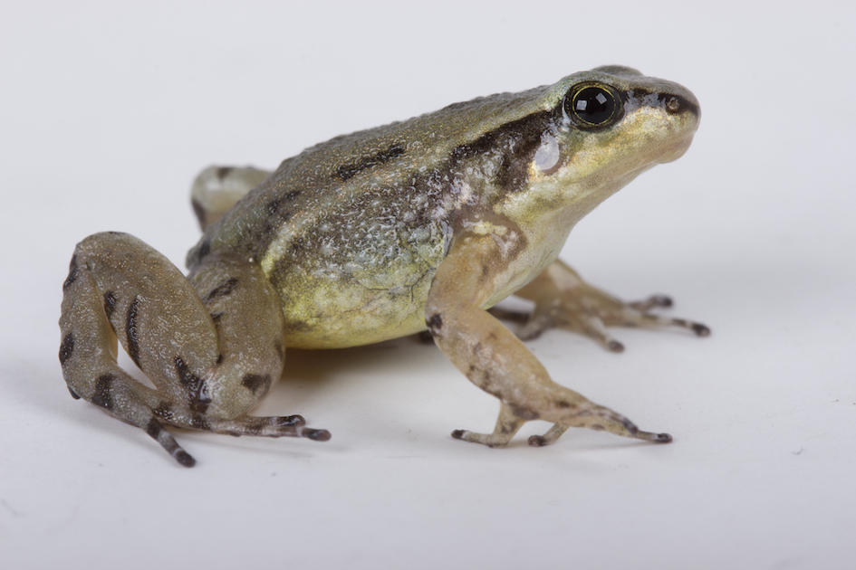
Rocket Frogs
On all honesty, I didn’t expect to see one of these.
I found it on my kitchen after a heavy rain, and took it outside later.
These are not very commonly found anymore. Maybe 10 years ago or so I would be able to see some of them in the garden, but now they are a rare sight.
Somehow I was happy I found it.
Video on the right side.

